Slide 1




eFront SDLC Assessment
Survey: goo.gl/9hgRJt
DevOps Playground #20
Hands on with Kubernetes
Anthony Forster
anthony@ecs-digital.co.uk
linkedin.com/in/anthony-forster

Slide 2


About Me
DevOps & Continuous Delivery Consultant
Experience Building CI/CD Pipelines
anthony@ecs-digital.co.uk
linkedin.com/in/anthony-forster

Slide 3
Agenda
Kubernetes Concepts
Jenkins Distributed Build Architecture
Demo
Pizza & Beer!

Slide 4
Preparations
Please connect to our Wi-Fi!
SSID: ECSDHOTSPOT
Password: entry-ind2x&creed=blade
GitHub URL: goo.gl/8n44za

Slide 5

Kubernetes

Slide 6
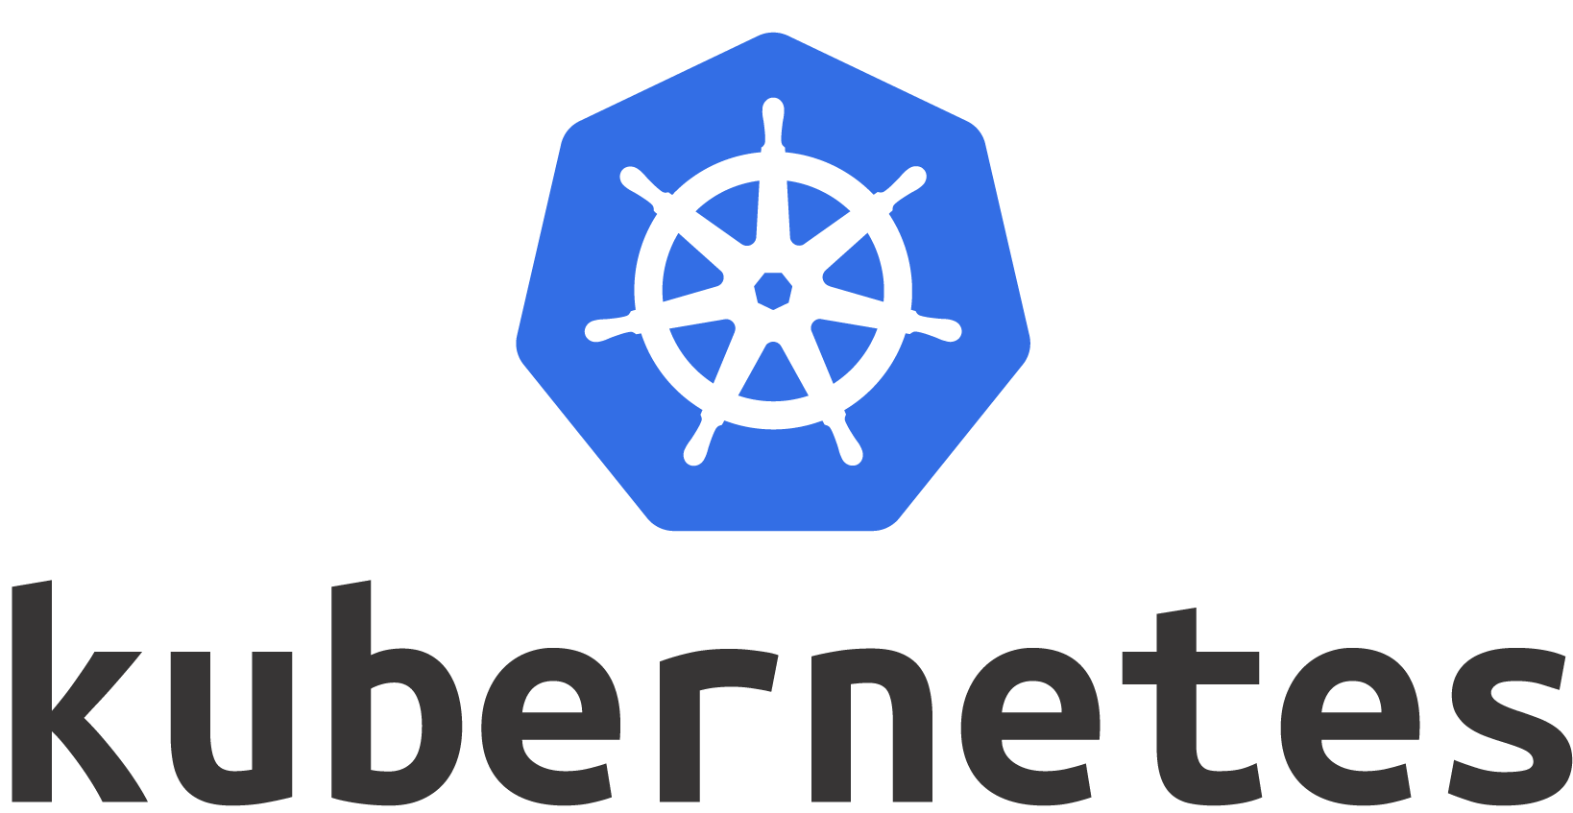
What is Kubernetes?
Notes:
Popular, open source container orchestration platform.
Used to automate the deployment, scaling and management of containerized applications.
Originally created by Google, now managed by the Cloud Native Computing Foundation.

Slide 7
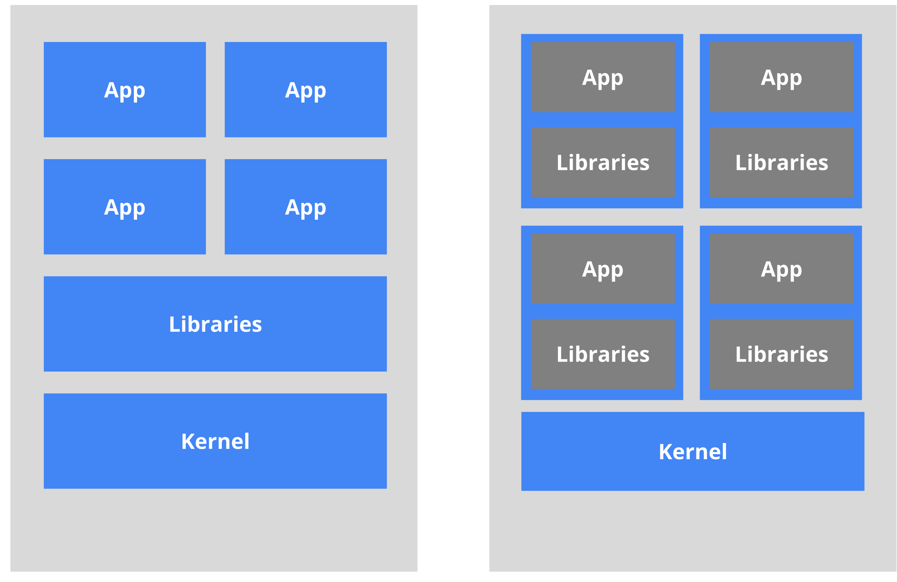
Why Containers?
Old: Without
New: With
Notes:
Old
Tangling of app and libraries, configuration files, executables, to the host machine
Often making it harder to deploy from one environment to the next
New
Provides immutability
Containers encapsulate all application dependencies.
No more unicorn builds.
Push one artifact from dev all the way to prod.
Self documenting - Dockerfile
Easier to scale

Slide 8
Kubernetes Concepts

Slide 9
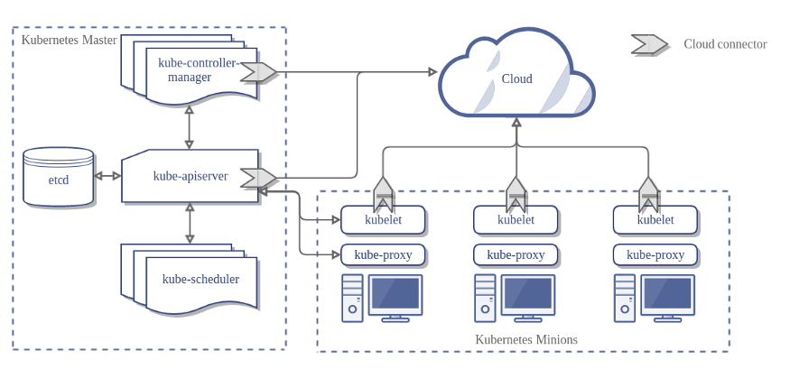
Kubernetes Architecture

Slide 10
API Objects
apiVersion: v1
kind: Service
metadata:
name: jenkins
spec:
type: NodePort
ports:
- port: 8080
name: "http"
targetPort: 8080
protocol: TCP
- port: 50000
name: "agent"
protocol: TCP
selector:
app: jenkins
Define desired state
Use kubectl to interact with the API server

Slide 11
Common Object Types
Pod
Service
Volume
Deployment
Many more…

Slide 12
Jenkins

Slide 13
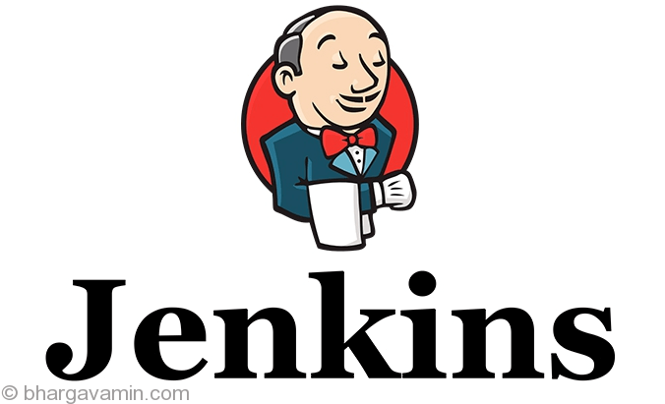
What is Jenkins?

Slide 14
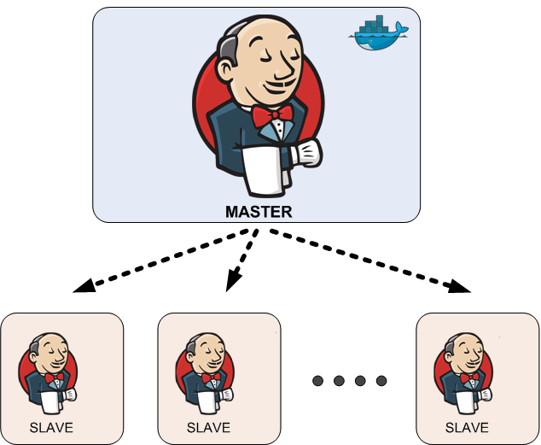
Distributed Build Architecture

Slide 15
Hands On

Slide 16
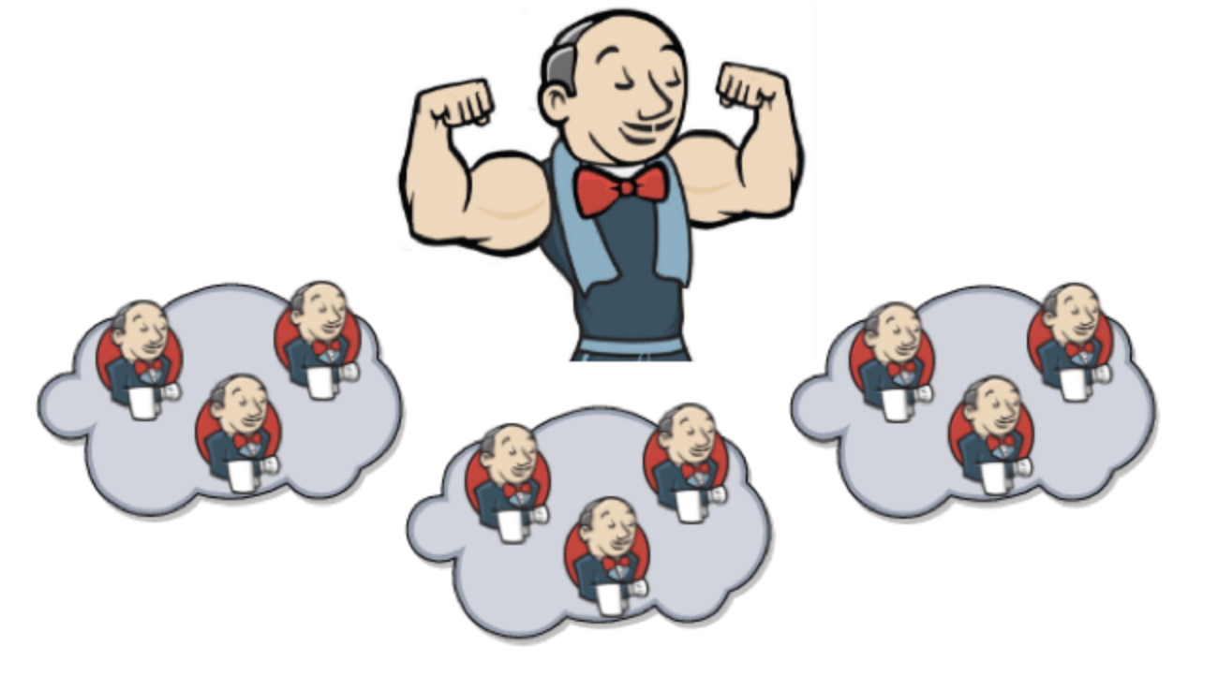
Overview

Slide 17
GitHub URL
goo.gl/8n44za

Slide 18
Summary
Covered Core Kube Concepts
Jenkins Master/Slave Model
Learned how to deploy Jenkins onto Kubernetes
Managed to provision Jenkins slaves to execute work

Slide 19


Thank You! Help yourself to 🍕 & 🍺

